Slide 1
AI Social Media Coordinator (Facebook)
What I Built:
a local Llama 3.1 agent that reads Page comments and replies via the Facebook Graph API

Slide 2
Agenda
Business goal and constraints
What we built (repo + components)
Meta/Facebook developer setup (tokens + permissions)
How the agent works (polling + LLM + posting)
Reliability, safety, and troubleshooting
Next steps / roadmap

Slide 3
Problem And Solution

Slide 4
Business Goal
Goal:
Reply to new comments quickly and consistently
Use local Llama 3.1 (Ollama) for privacy + cost control
Avoid duplicate replies and unsafe/incorrect claims
Constraints:
Must use Facebook Graph API + correct Page permissions
Tokens expire; production needs long-lived token strategy
Visibility/moderation can hide replies from the public

Slide 5
What I Built:
Python agent that polls Page posts and reads new comments (Graph API)
Reply generation using local Ollama model: llama3.1
Auto-reply posting back to Facebook comments
SQLite state to prevent double replies
Reply sanitization (removes invisible/control chars)
Visibility checks (is_hidden/is_private) + auto-unhide attempt
Dry-run mode for safe testing

Slide 6
Meta / Facebook Developer Setup
Create app → permissions → generate Page access token → configure .env

Slide 7
Required Permissions (Typical For Page Comment Reply)
pages_show_list (so /me/accounts returns your Pages)
pages_read_engagement (read comments/engagement)
pages_manage_engagement (reply to comments)
pages_manage_metadata (commonly required for Page reads)
Note: App Review/Advanced access is required for production use beyond your own assets.

Slide 8
Token WorkFlow
1) Generate a User access token in Graph API Explorer with the permissions above
2) Call GET /me/accounts to list Pages you manage
3) Copy the Page id → FB_PAGE_ID
4) Copy the Page access_token → FB_ACCESS_TOKEN (this is what the agent uses)

Slide 9
Local configuration (.env)
Create /workspace/.env (exact name) next to requirements.txt
Set FB_PAGE_ID and FB_ACCESS_TOKEN
Set DRY_RUN=true for first tests; switch to false to post replies
Set OLLAMA_MODEL=llama3.1 and ensure Ollama runs on OLLAMA_HOST

Slide 10
System Design & Workflow
How Graph API + Ollama + SQLite state work together

Slide 11
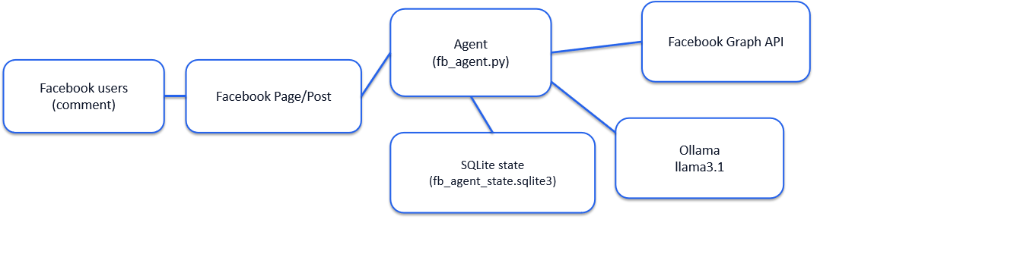
High-Level Architecture

Slide 12
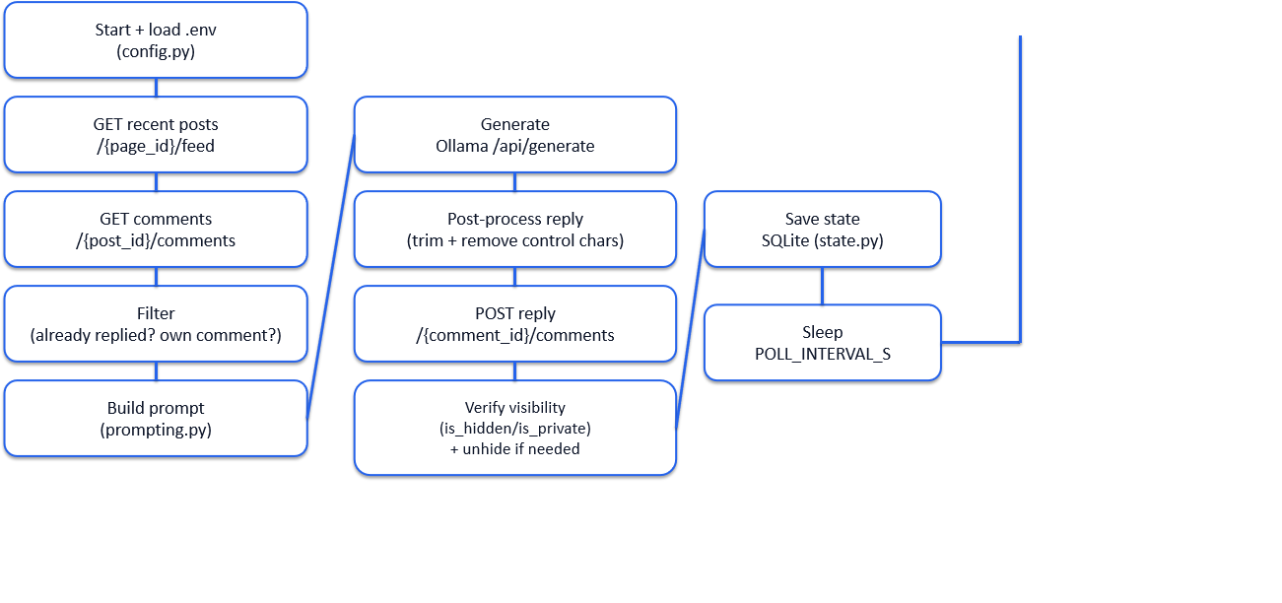
Main loop (poll → decide → generate → post)

Slide 13
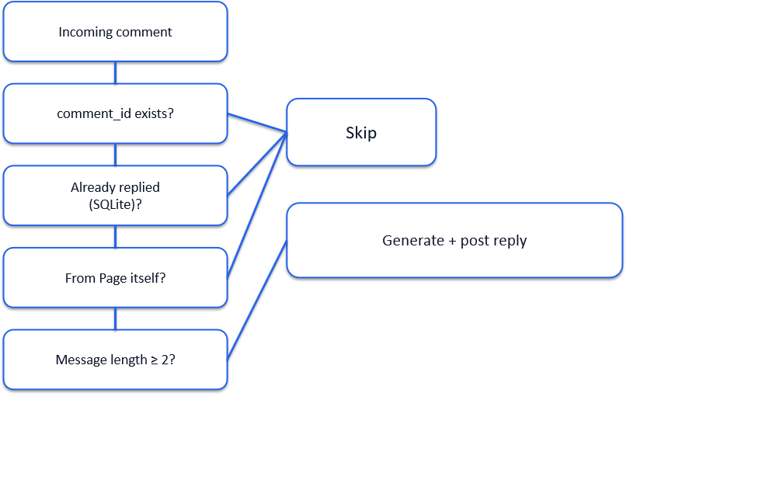
Decision Tree (Should We Reply ?)

Slide 14
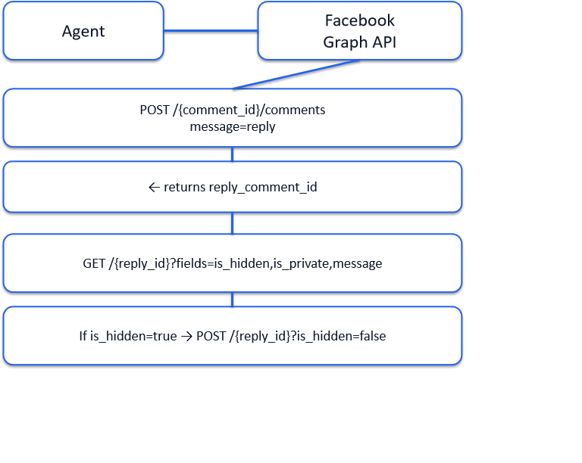
Post + Verify Visibility (Sequence)

Slide 15
Reliability, Safety & Troubleshooting
What we changed to make it robust in real usage

Slide 16
Safety & quality controls
Short replies (1–3 sentences)
No "I’m an AI" disclosure
No invented facts (prices/hours/policies)
Complaint handling: apologize + one clarifying question
SQLite de-duplication (prevents spam/double replies)
DRY_RUN mode for safe testing
Unicode sanitization (prevents blank/invisible replies)
Visibility checks (detect hidden/private replies)
Token redaction in error logs

Slide 17
Trouble Shooting Highlights
DNS error: failed to resolve graph.facebook.com → network/DNS/VPN/proxy issue
Fix: nslookup, switch DNS, disable
proxy/VPN, firewall allow Python
Owner sees replies but public doesn't → likely is_hidden/is_private or moderation settings
Fix: check reply flags via Graph API; unhide with POST ?is_hidden=false
Also review Meta Business Suite moderation filters

Slide 18
Next Steps
improvements for production

Slide 19
Roadmap
Webhooks (real-time) instead of polling
Approval workflow (human-in-the-loop) for high-risk comments
Spam detection + keyword rules + escalation to DM
Rate limiting + exponential backoff + structured logging
Multi-platform: Instagram comments, WhatsApp/DM triage

Slide 20
Thank You !

